Slide 1
Cisco Webex Teams: Installation and Registration
Get a free user account and API access token.
Release 20181212

Slide 2
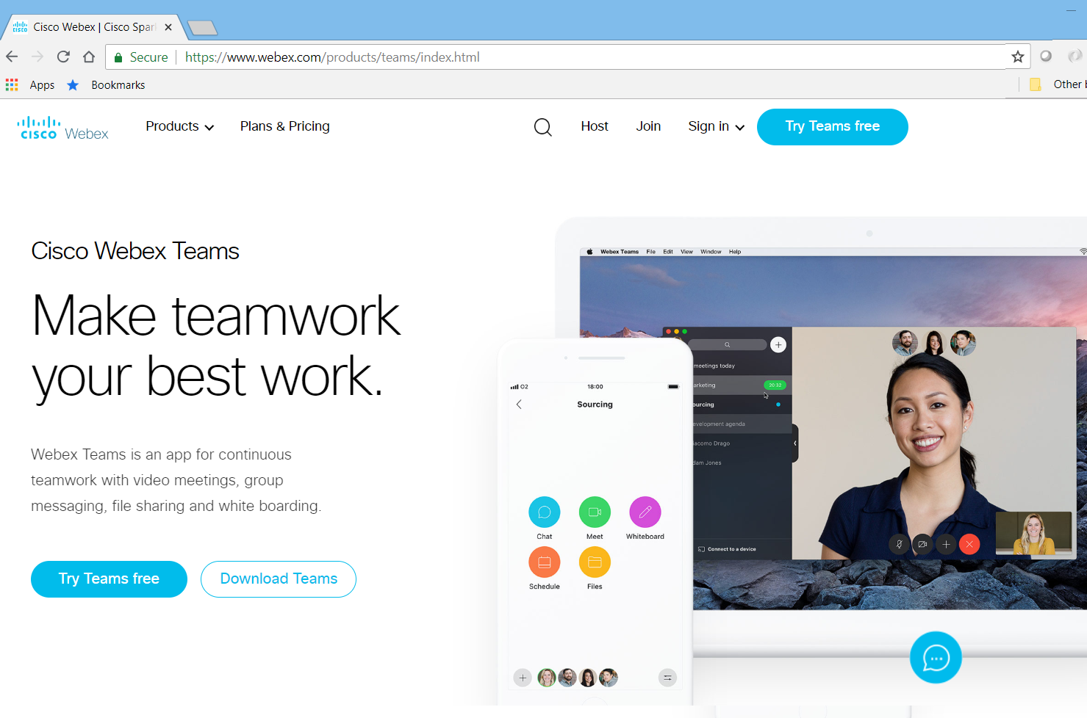
1. Download the Webex Teams Client
Go to: www.webex.com/products/teams
Download the client.

Slide 3
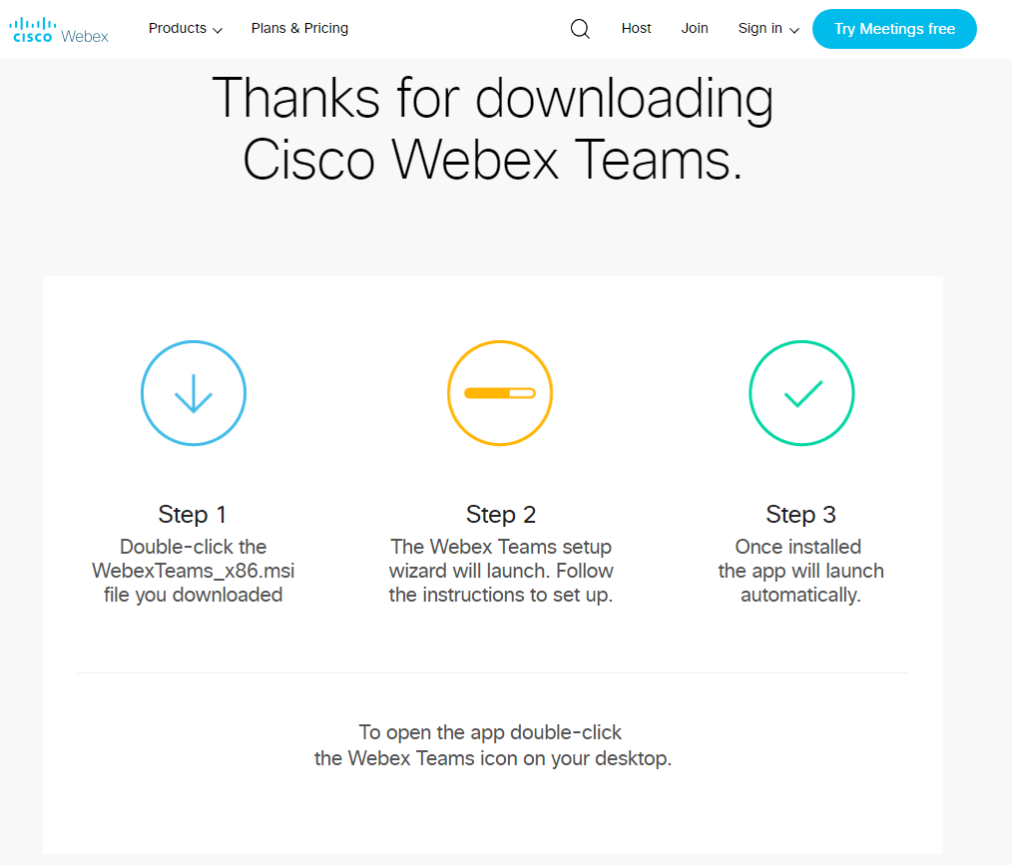
2. Install the client
Run the installer.
Follow the prompts to install the Webex Teams client.
You will need to provide and verify a valid email address.

Slide 4
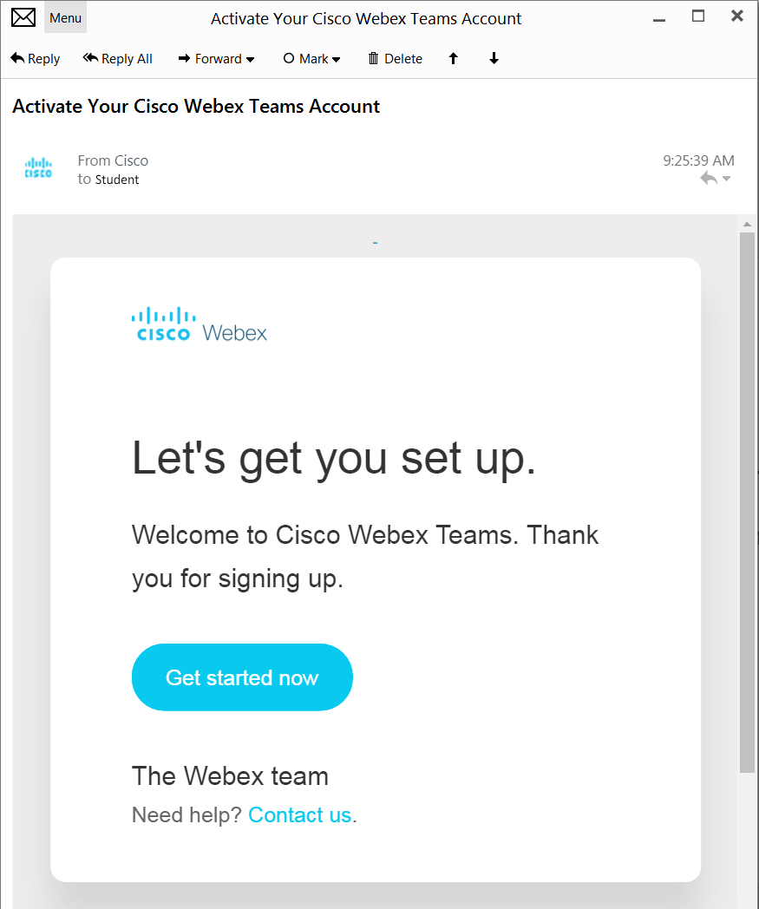
3. Begin Registration
Open the activation email.
Click on the Get started now link to register your new Cisco WebEx Teams account.

Slide 5
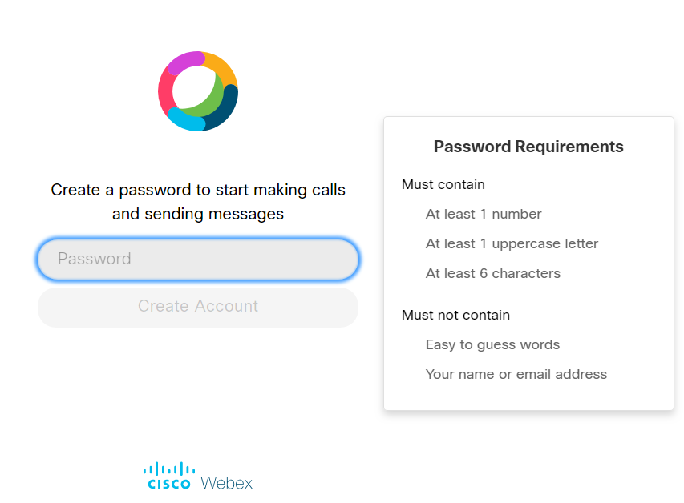
4. Complete the registration
Set your Cisco WebEx Teams account password and create your account.

Slide 6
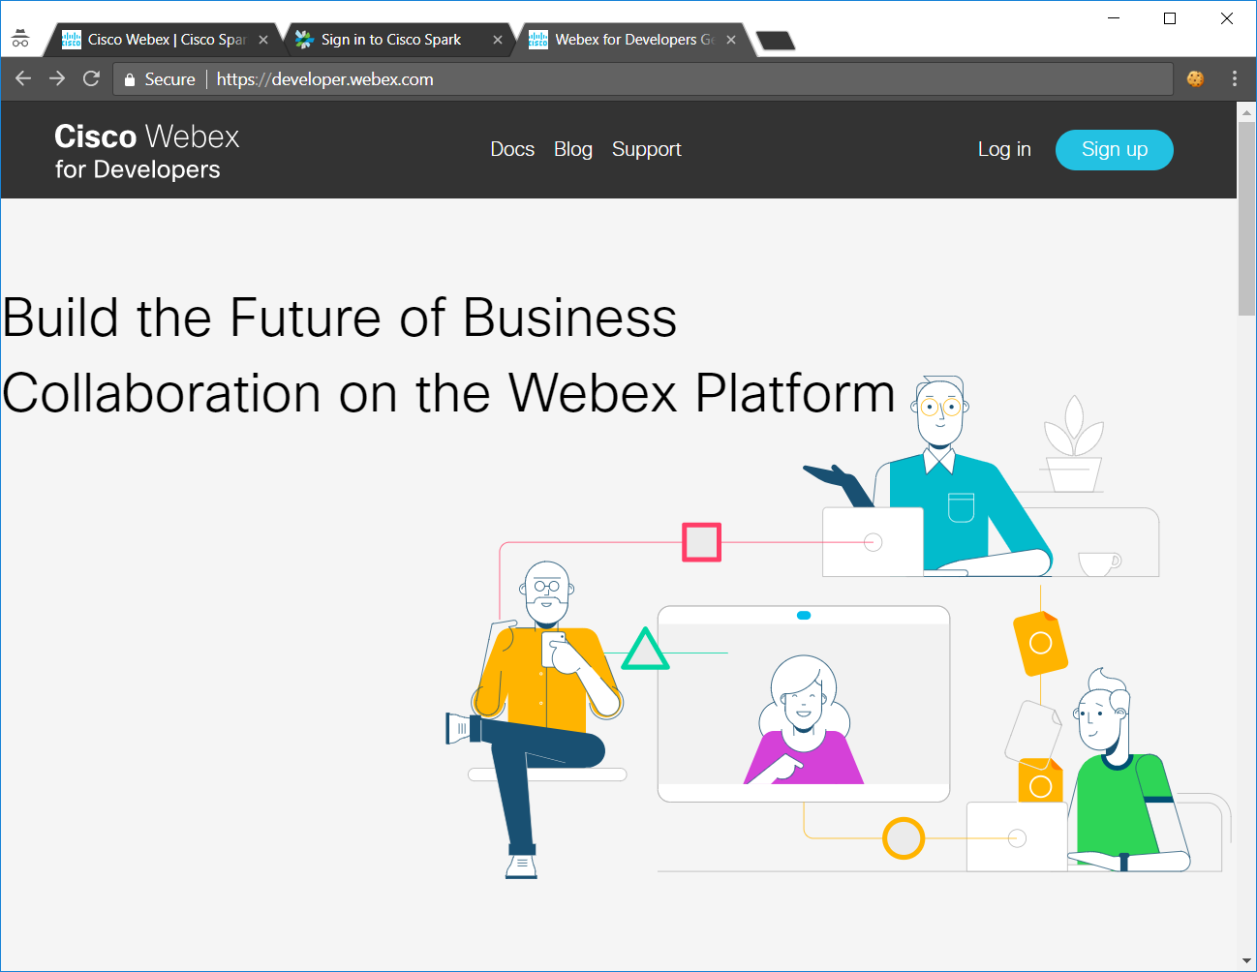
5. Go to developer.webex.com
Click on the Log in link and login to your new account.

Slide 7
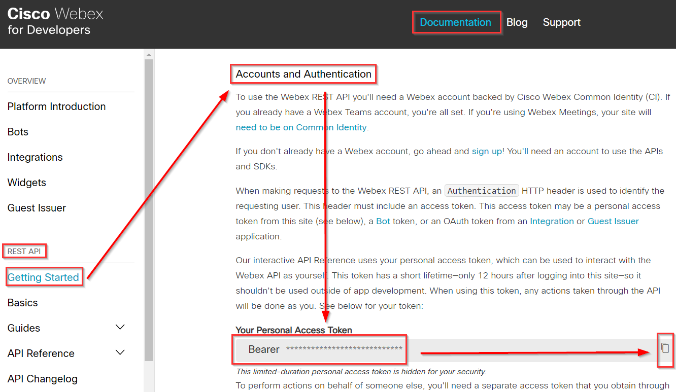
6. Get your Personal Access Token (option1)
Click on the Documentation link.
Scroll down to REST API.
Click on the Getting Started link.
Scroll down the page to the Accounts and Authentication section to get your Access Token
Stay logged in to the Cisco Webex for Developers web site or the access token will change.
The Personal Access Token will expire in 12 hours.

Slide 8
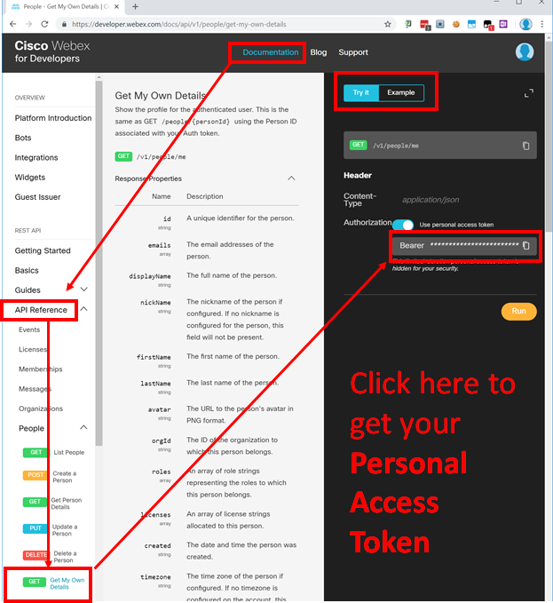
6. Get your Personal Access Token (option2)
Click on the Documentation link.
Scroll down to API Reference.
Select any of the API endpoints, e.g. the People->Get My Own Details endpoint.
Click on the Authorization Bearer copy icon to copy your Personal Access Token.
Stay logged in to the Cisco Webex for Developers web site or the access token will change.
The Personal Access Token will expire in 12 hours.

